Slide 1
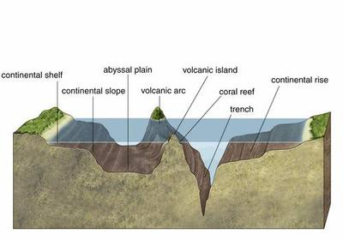
Seafloor Modeling and Mapping Lab

Slide 2
Purpose
To create a model of the seafloor and its features.
Simulate bathymetric mapping techniques.
Convert a bathymetric map into a profile map.

Slide 3
Materials
Shoebox ocean
Playdough
Scissors
Tape
Graph paper
String: (16.5 Ft, total – 11 pieces that are 10”, 6 pieces that are 15”) don’t stretch it when measuring!!!
Ruler and skewer stick

Slide 4
Procedure
In your shoebox ocean, make a model of the ocean floor with playdough of the following features:
Cont. shelf, slope, and rise, guyot, trench, mid-ocean ridge, seamount, abyssal plain, and submarine canyon
Make a graphing transect across the top of your ocean (see next slide)
Take depth readings at each string intersection (1 cm=100m)
Record those readings on your graph paper
Pick a transect line to use the data for a profile map.

Slide 5
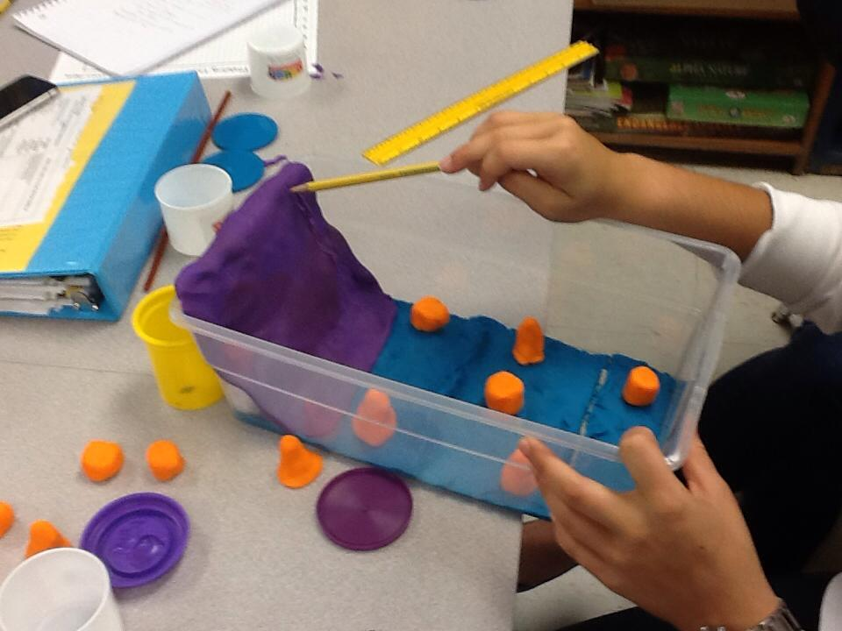
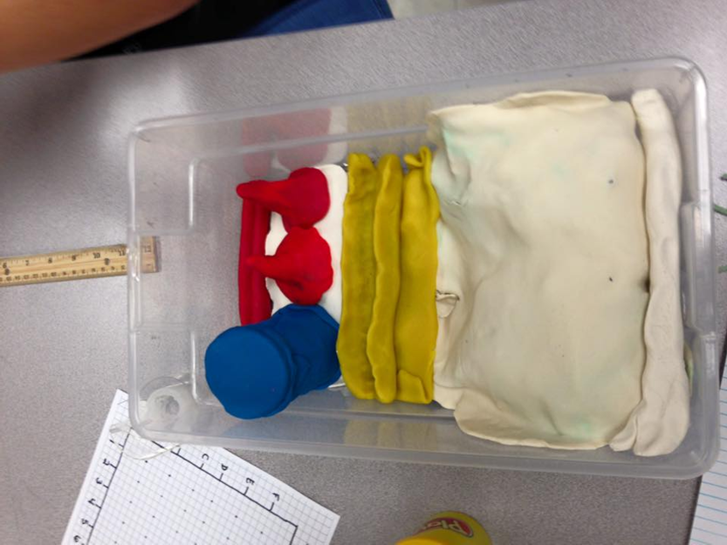
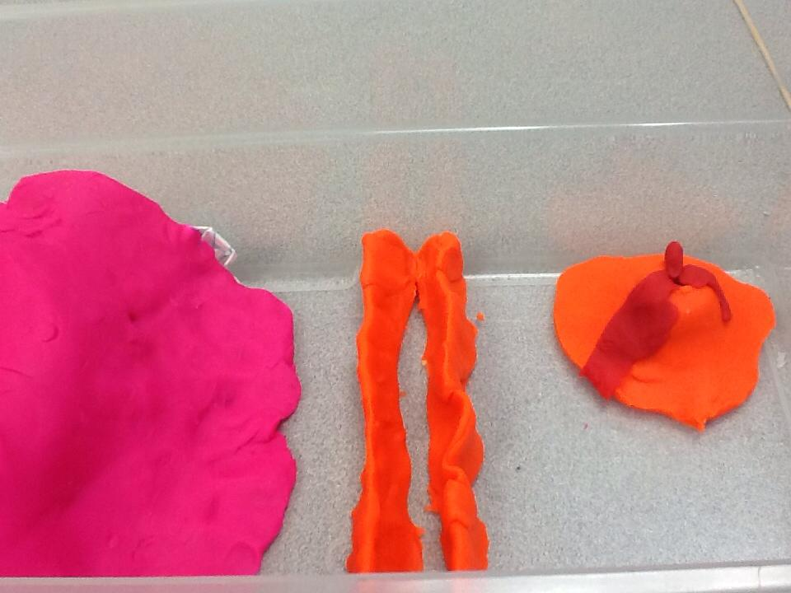
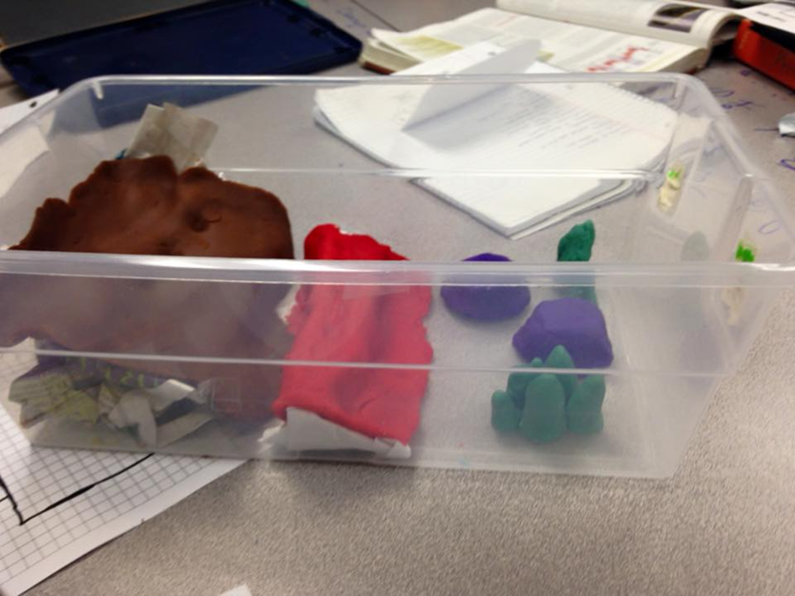

Slide 6
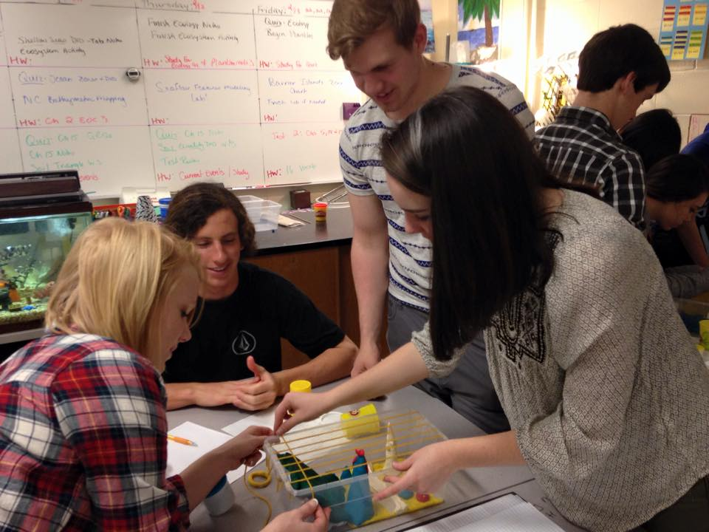
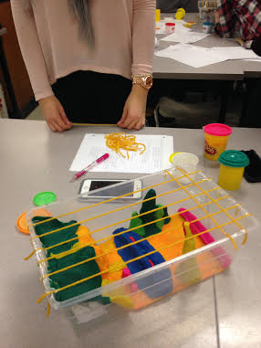
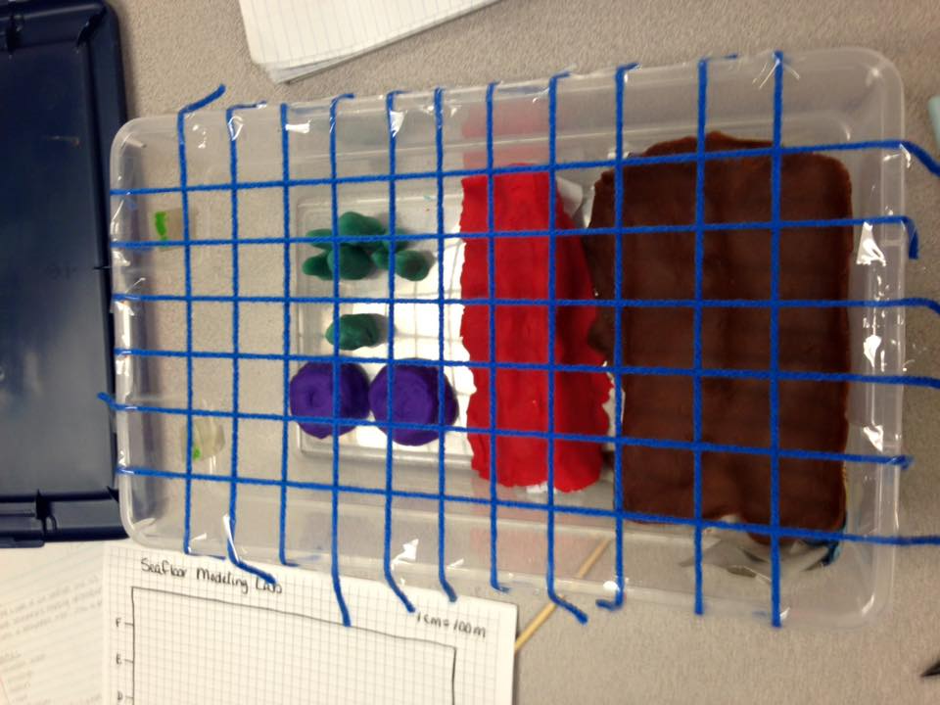

Slide 7
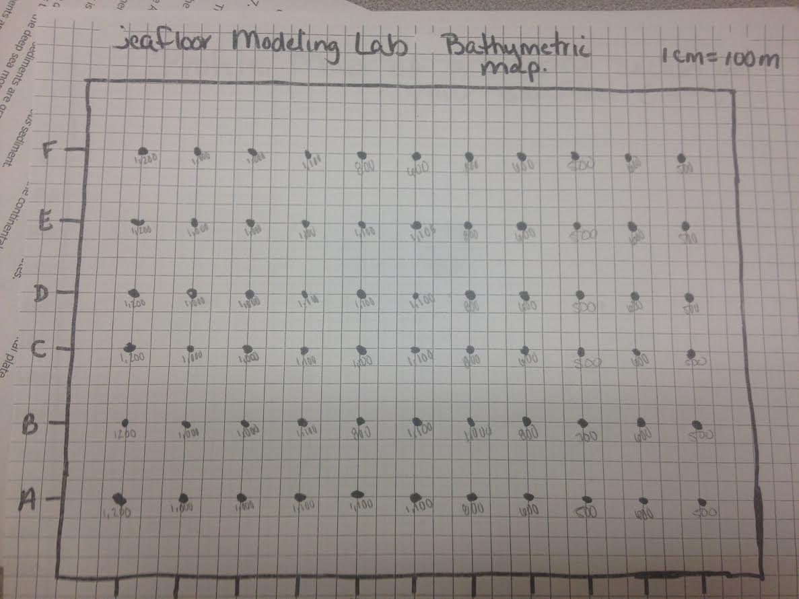

Slide 8
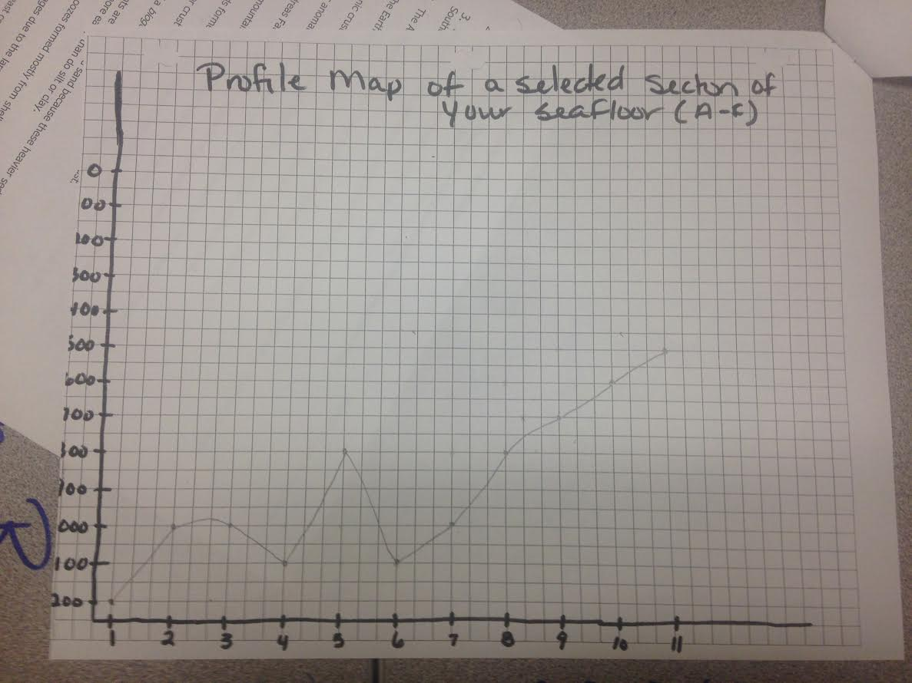

Slide 9
Conclusion
Define the following features in your OWN words:
Cont. shelf, slope, and rise, guyot, trench, mid-ocean ridge, seamount, abyssal plain, and submarine canyon
What was the depth of the shallowest point you measured? The deepest?
What is the difference between a bathymetric map and a profile map?

